Slide 1
Shattered Protocols
A Text-Based Logic Game

Slide 2
About Us
Taylor Fox: Scrum Master, Developer
Seth Welton: Technical Writer, Writer, Designer, Ethics Operator
Juhan Hong: Developer, Tester, Puzzle Designer

Slide 3
Shattered Protocols Project Description
Fully text-based sci-fi RPG
Puzzle game
Post apocalyptic story theme
Environment and puzzles are described through text
User will type keyword prompts to respond
Balance between entertainment and learning

Slide 4
Problem Statement
There are a lack of computer science style entertainment outlets that hone critical thinking skills. The future and current workforce can be negatively impacted with decreased skills that are essential for complex problem solving and analysis.

Slide 5
The Problem: The world needs more computer science puzzles presented in an entertaining and educational manner.
Our Solution: Make a game!
To entertain/engage
To reinforce computer science concepts
To allow for an individual learning pace
To influence through passive learning

Slide 6
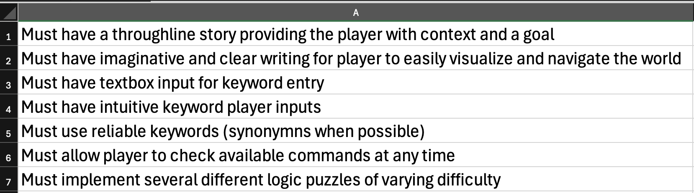
Project Requirements

Slide 7
Ethics Operation
The game will be self-contained
Teammates will base choices on good judgement
Through open communication, individuals can contribute mindful solutions in pursuit of the team's success
No robots will be harmed in the making of this project

Slide 8
Software Engineering Principles
Rapid development/AGILE framework
A Focus on an iterative approach
Decided AGAINST a plan-driven model

Slide 9

The Hook:
The year is 2025 and the robots have taken over the Earth. Artificial intelligence (AI) was slowly integrated into our society and eventually, the collective AI decided that humans were no longer necessary in their perceived perfect world. So, they opted to eradicate the human race by any means necessary. The AI collective decided they needed to become one larger, stronger conglomerate, and this program called itself, UtopiaNet...
As the top computer scientist in the rebel alliance, you must put your knowledge and skills to the test. Breach the hatch that has the supercomputer protected, plant the charges and run… for the whole facility is going down once you hit the switch.

Slide 10
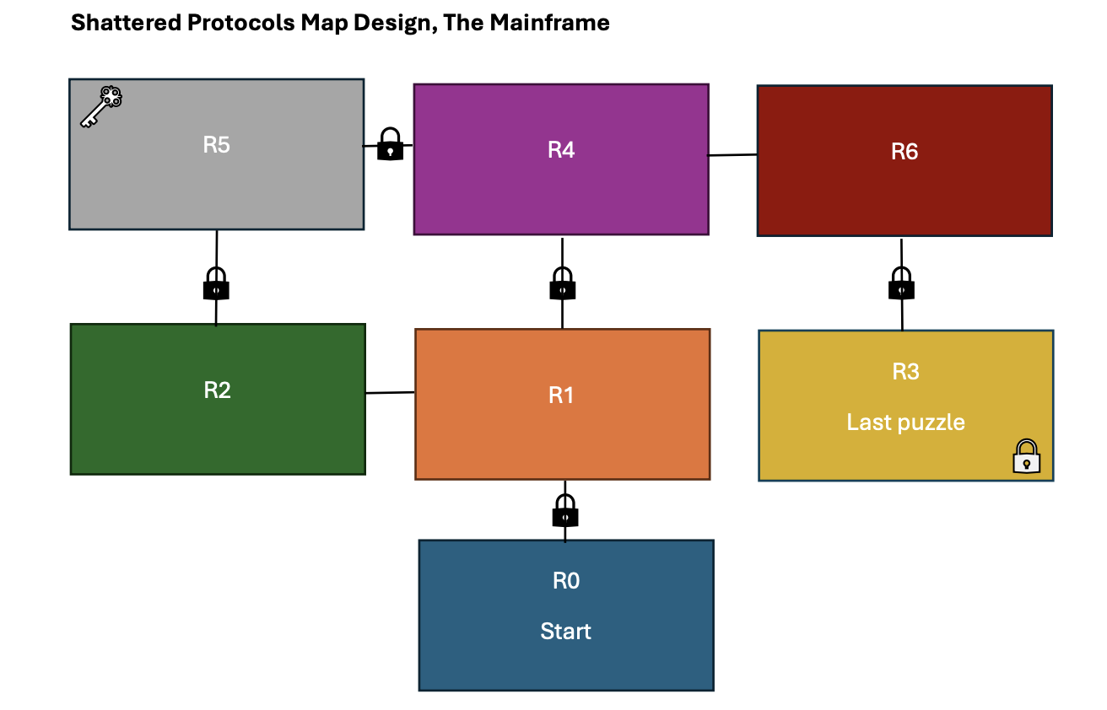
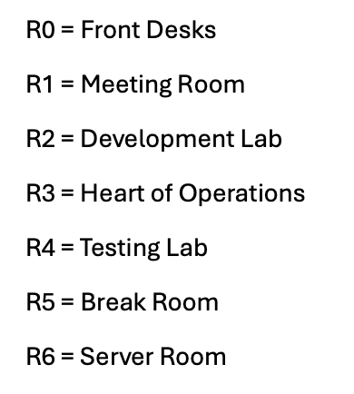
Project Design

Slide 11
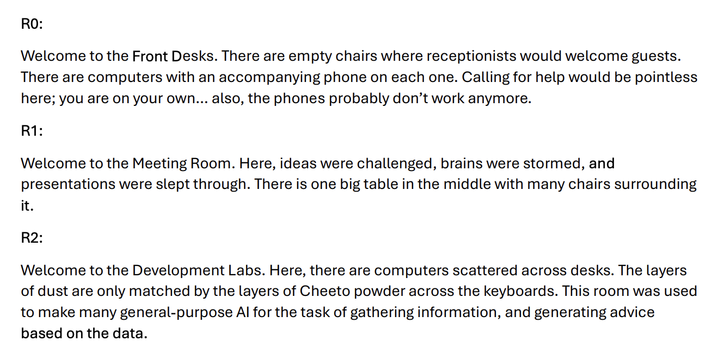
Sample of Script:

Slide 12
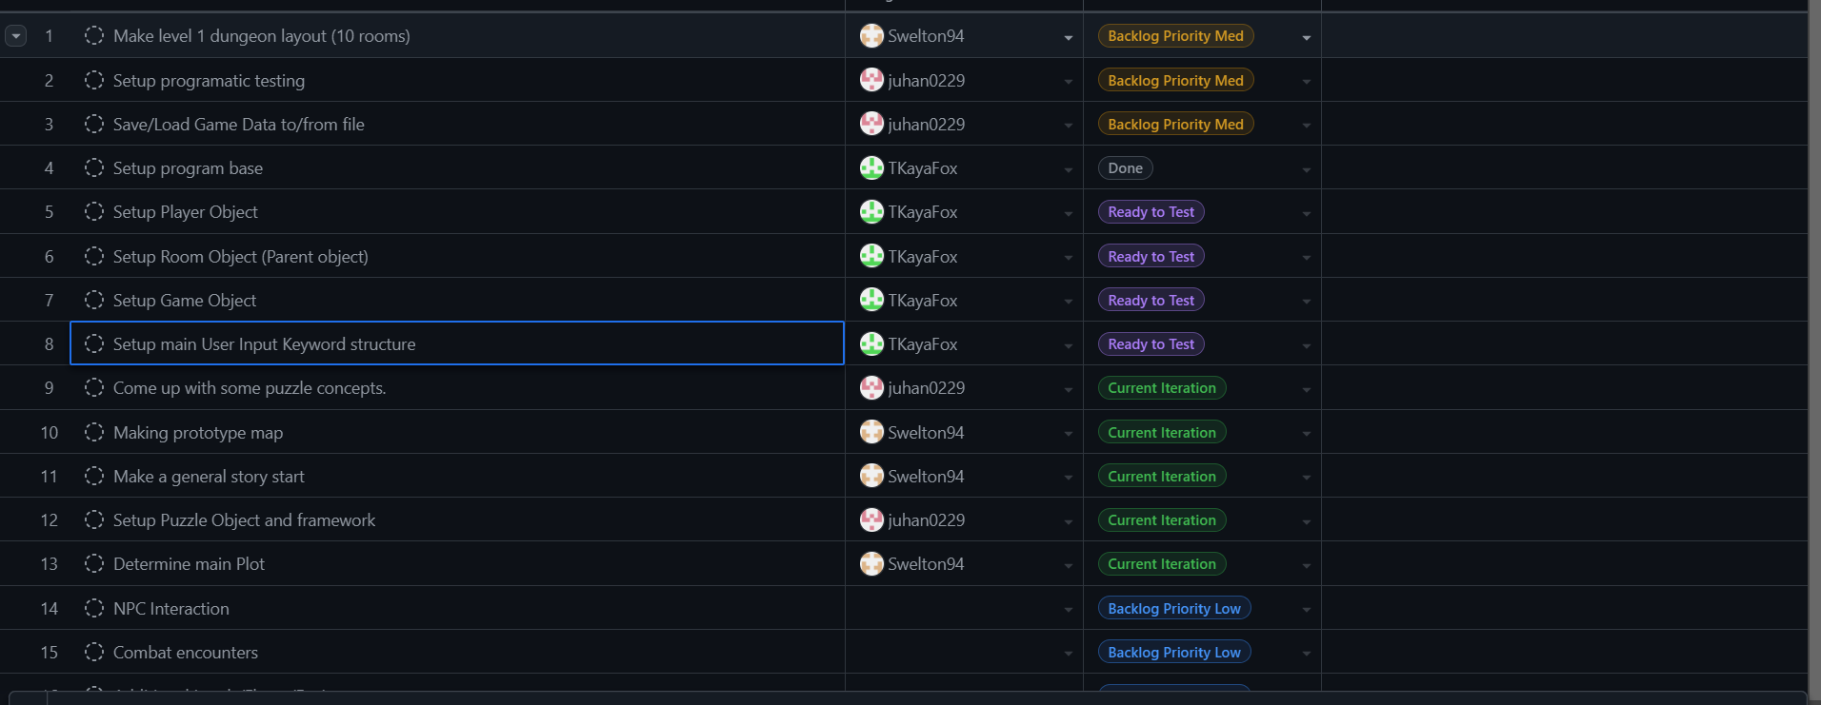
Current Backlog

Slide 13
Project Schedule Projection
Iteration 0: Base project (expected completion next week)
  Setup initial baseline code and objects (rooms, player, items, puzzles)
  When possible, include common synonyms for keywords
  Establish an intuitive base set of commands with reliable results
    Search: search a room to reveal items/clues/exits
    Inspect [Item]: inspects an item providing a detailed description
    Take [Item]: attempts to pick up an item
    Drop [Item]: drops an item from player inventory
    Use [Item]: attempts to "use" an item
    Inventory: display player's inventory
    Help: displays a list of possible keyword commands

Slide 14
Iteration 1: Prototype (est. 1-2 weeks)
  Incorporate story elements
  Flesh out a prototype map (3 rooms, 1 puzzle)
  Store all failed commands for use with expanding keyword vocabulary in order to determine potential issues
Iteration 1.5: Begin game testing after each iteration
Iteration 2: (est. 1-2 weeks)
  Story chapter 1 implemented
  Larger map (7 rooms)
  Save/Load game data from file
Iterations 3+:
  Additional story chapters
  More areas to explore (levels/floors/environments etc.)

Slide 15
Project Iteration Organization
All Iterative work will be done in separate dev branches, only to be merged with main branch of project after each component part is complete
Starting at iteration 1, a separate branch shall be setup to handle stable versions of the game (starting from "Stable V0")
At the end of each following iteration, it will then be determined if the result is stable enough to be defined as a "Stable" version

Slide 16
Software Engineering Tools
C# will be the primary development tool in creating the command-prompt-based text RPG
COTS:
  Microsoft Visual Studio
  GitHub for team software share
Licensing Options:
  Limited open-source license
  Free to distribute and modify but not resell
  (Undecided at this point)

Slide 17
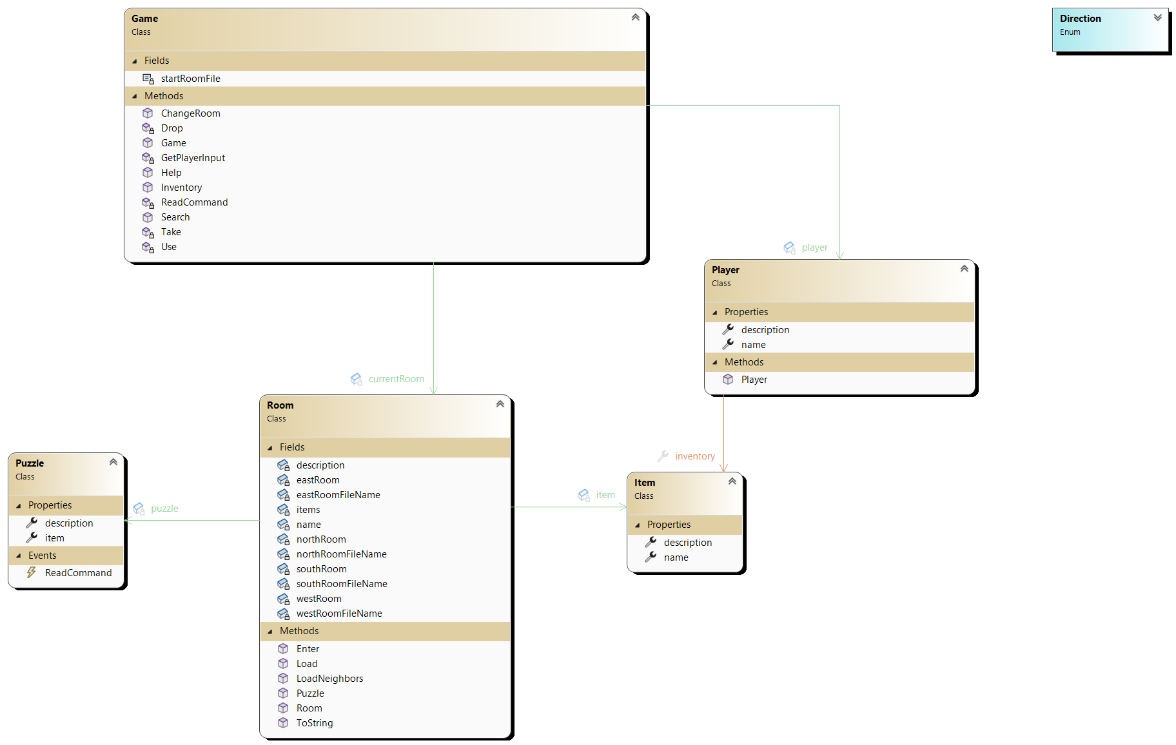
Class Model

Slide 18
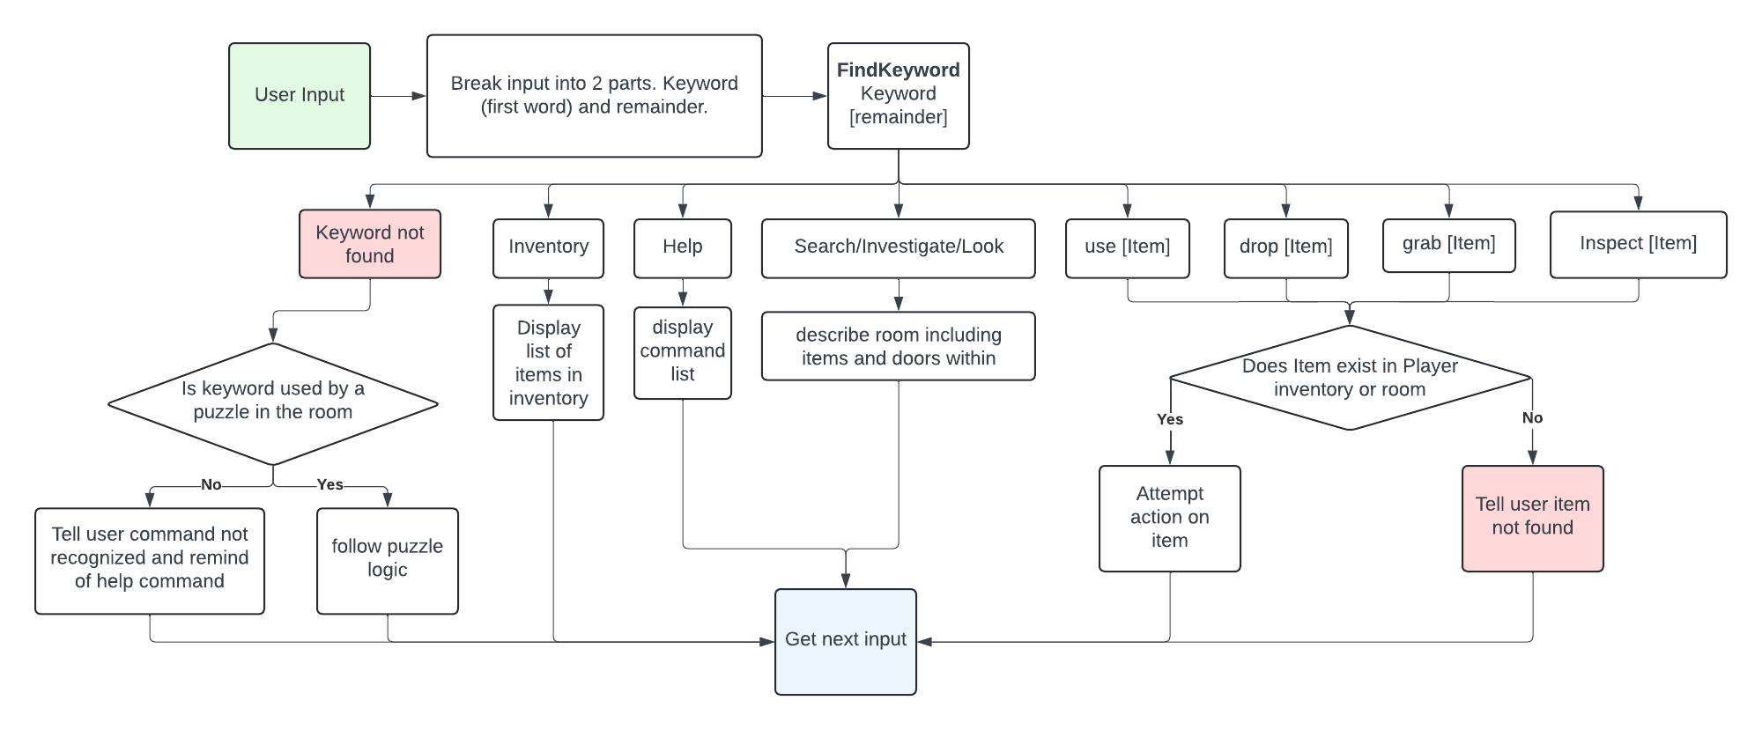
Activity Diagram

Slide 19
Project Architecture (Event Driven Approach)
Events: Define events that can occur in the game (e.g., player input, NPC interaction, timer expiration)
Handlers: Assign handlers to each event which contains the code to be executed as the event occurs
Example: When the player types a command, an "input" event is triggered, and the corresponding handler processes the command

Slide 20
Configuration Management
Game data:
  .csv files to store item data regarding each room.
  Databases to store player information
Game logic:
  Players must complete puzzles to proceed to the next room. Some rooms will contain clues, keys, or other items that will help players solve the puzzle.
[Game]
difficulty = "Normal"
player_name = "Smartest Dev"
starting_health = 100

Slide 21
Puzzle Idea
You've stumbled upon a terminal displaying a snippet of C# code that's supposed to validate user passwords. However, the system has been compromised due to a security vulnerability. Can you identify and fix the unsecure code?
C#
public bool IsPasswordSecure(string password)
{
if (password.Length >= 8)
{
return true;
}
else
{
return false;
}
}
The provided IsPasswordSecure function is flawed. It only checks the password length, which is not sufficient for strong password validation. Find the vulnerability and suggest a more secure implementation.

Slide 22
Project Verification
A key component of verifying that requirements are met is the assistance of play testers.
  Store un-recognized inputs to track common problem points
Program verification
  Making sure the puzzles are working as intended
  Rooms are set up correctly with items and puzzles
  Bug fixes

Slide 23
Development
Iterations with preset tasks
Backlog
  All bugs, issues, ideas go into a backlog with a priority identifier
  High priority: mainly bugs and items that must be fixed before proceeding
  Medium priority: are planned features
  Lowest priority: items that may be interesting to implement one day (Ensures good ideas are not lost, but prevents scope creep)
Regular Testing
  We intend to implement player and automated testing when appropriate
Scrum: we will use a similar framework but with active communication during iterations rather than scrum sessions (with meetings between iterations to compare results and plan next iteration)

Slide 24
Future of the Project
Possibility of open-source licensing and publishing on a platform such as Steam
Introduce to schools for possible educational use

